Slide 1
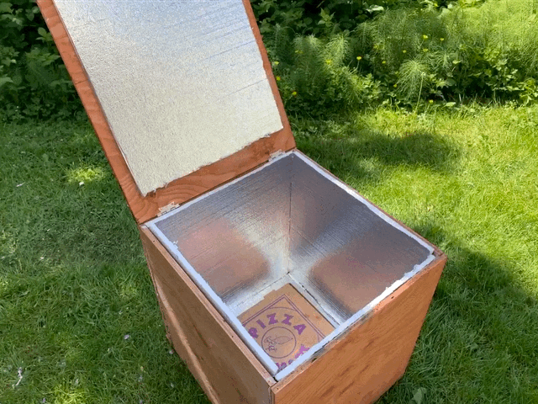
3D Solutions
Elius Graff, Christian Myhre, Sean Liu, Matthew Wolf, Eriko Nugroho

Slide 2
Block Diagram

Slide 3
Summary Subsystem Testing Results
Sterilization
Cost
IP-52
Factor of Safety

Slide 4
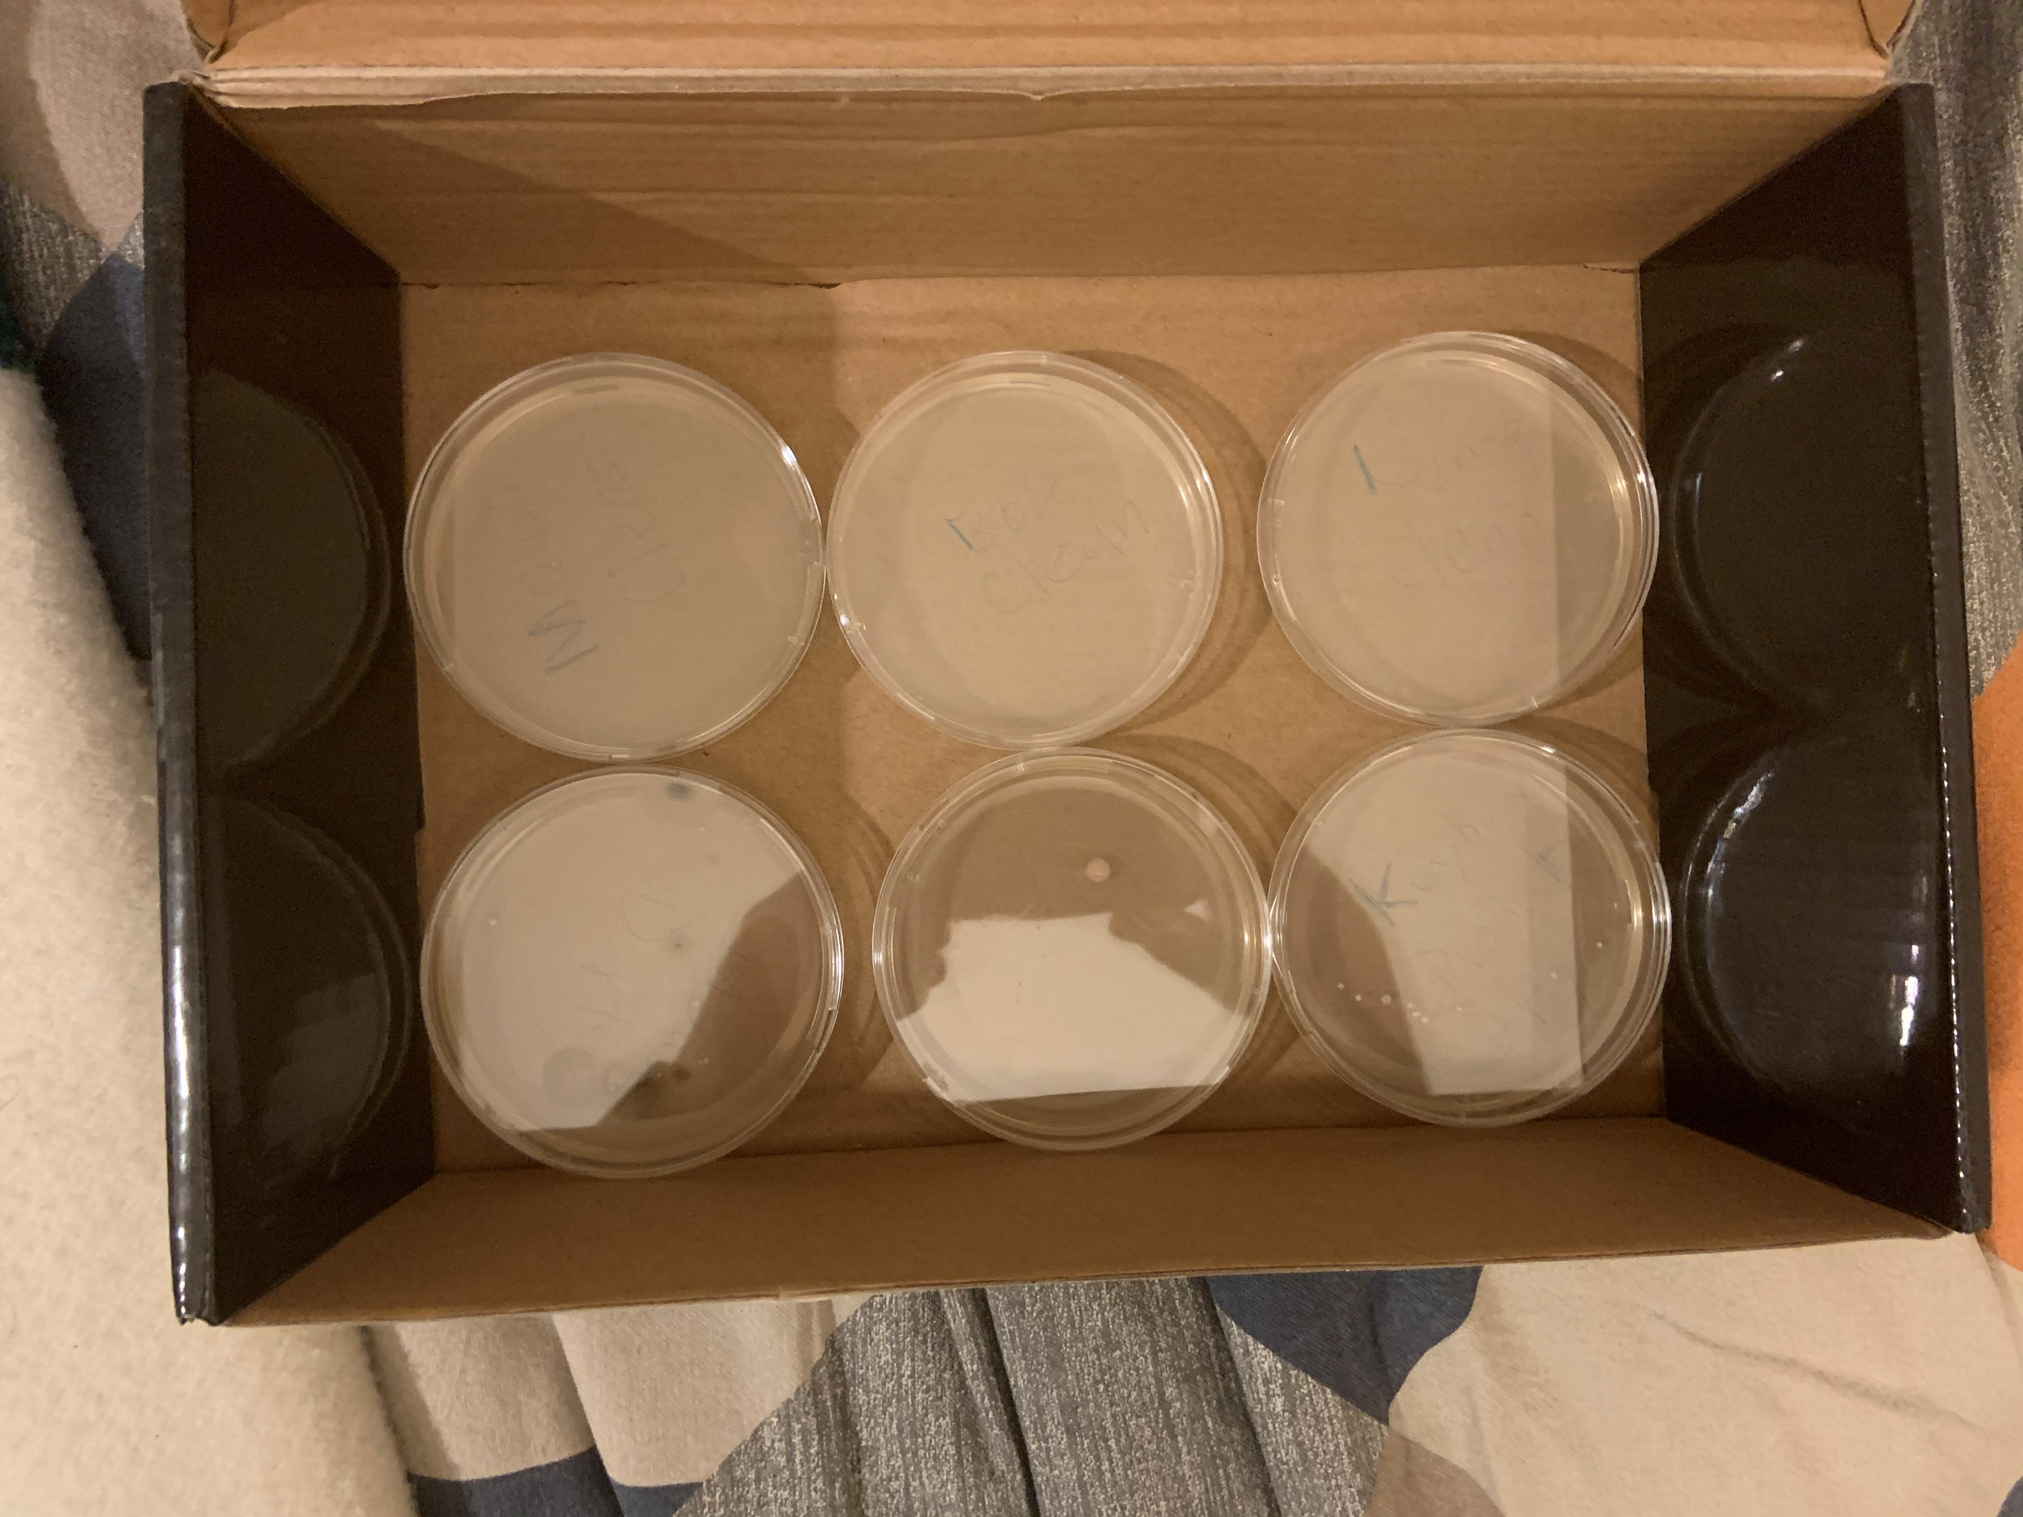
Sterilization Testing
What we did
Collect dust or germs with a Q-tip from an object into Petri dish
Putting the dirty object in the UV light (1min) and using a Q-tip to take a sample into the Petri dish

Slide 5
Cost Summary: "Shall cost less than $300"
Spent $331.70.
Lots of 'non-renewable' costs.
Estimate at least $90 less next time – This is within budget!

Slide 6
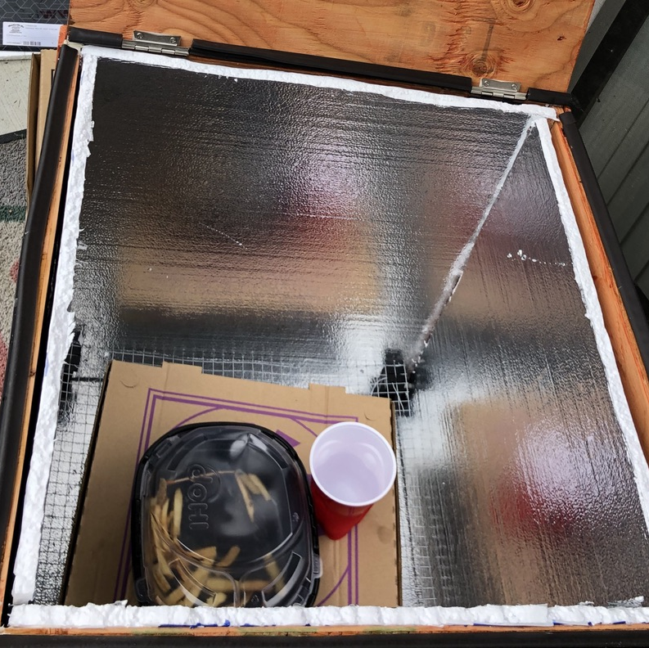
IP52 Standard Testing
SPEC: The product shall maintain IP52 protection.
WHAT WE DID
Placed contents inside box.
Simulated 3 mm of rainfall/minute for 40 seconds.
Analyzed contents inside.
Passed test.

Slide 7
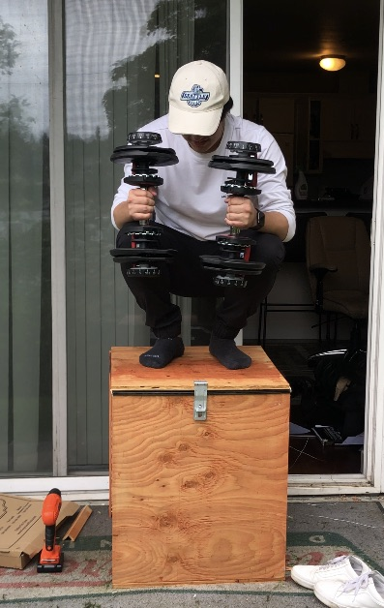
Factor of Safety Testing
SPEC: The product’s structure shall support 30 kg load applied to the top and should be able to support 80 kg applied to the top.
WHAT WE DID
Applied 160 lbs on lid.
Added 20 lbs until 200 lbs.
Analyzed box for bends/creaks.
Passed test.

Slide 8
Electrical Challenges and Solutions
Challenges
Logic designs were continuous
ICs weren't rated for supply voltage
ICs didn't work
Needed circuit components
ICs didn't supply enough current
Dangers with large power source
Broken Lamp
Solutions
Use clocked logic gate
Had to buy different ones
Get creative!
Run lots of simulations
Used a solid-state relay
Take caution
Return/replace

Slide 9
Mechanical Challenges and Solutions
Challenge
Failed 3D prints/getting supports out of seams.
Waterproof seal made the lid uneven.
Support tray corner became defective, wire grid disconnected from itself.
Screwdriver is unable to fit under support bracket to get bottom screw in.
Solution
Watched print so that it didn't continue, redid print.
Added hinge spacer to make lid flush.
Solution would be to weld or glue corner back together.
Screw from wood side upward and attach bolt.

Slide 10
Takeaways
Double check IC ratings
Buy more than 1 IC when ordering
Build electronics in a lab
Use separate testing environment/circuit
Think about assembly long before actual assembly
Update schedule more frequently
Don’t go back unless you have to

Slide 11
Brought to you by 3D Solutions.
Thank you.

