Slide 1
Morpheus Hand
Joe Haj (EE), Eric Helke (EE), Sean Liu (ME), Kelvin Por (ME), Matthew Wolf (ME)
2 Feb 2021

Slide 2
Basic Device Functionality
Pinch and grab positions for the prosthetic
Able to lock into those positions
Harness to help support the weight of the prosthetic
Communication between the peripheral and prosthetic
Battery life to support extended time without recharge
At the end of Winter Quarter 2021, the basic device will be able to meet all the functional specifications outlined in this document

Slide 3
Functional Specifications: Mechanical
Spec ID | Requirement | Threshold (Shall) | Objective (Should) | Passes (Will) | Validation/Testing Method
ME01 | Locking into a grab position | >10 lbs. | >20 lbs. | N/A | Activate the lock and hold onto a 10 lb. backpack to the user’s side for 1 minute free from any surface.
ME02 | Locking into a pinch position | >.5 lbs. | >1 lb. | N/A | Activate the lock and pinch onto a pencil and hold it up. Also withstand .5lbs of pulling force.
ME03 | Harness should be able to hold on weight | > 8 lbs. | > 10 lbs. | N/A | Hold a backpack that is specified weight to the user’s side free from any surface for 1 minute.
ME04 | Harness breaking point | > 35 lbs/s. | < 40 lbs/s. | N/A | Lift a specified weight over 1 second and observe if detachment occurred.
ME05 | The prosthetic hand shall grab and hold | > 10 lbs. | > 20 lbs. | N/A | Grab and hold onto a 10 lb. backpack to the user’s side for 1 minute.
ME06 | The pinching function will hold force. | > .5 lbs. | > 1 lbs. | N/A | Pinch a pencil off the table and hold it up while being able to withstand a .5 lb. pulling force for 1 minute.

Slide 4
Functional Specifications: Mechanical
Spec ID ​ | Requirement ​ | Threshold (Shall) ​ | Objective (Should) ​ | Passes ​ (Will) ​ | Validation/Testing Method ​
ME07 | IP55 standards | N/A | N/A | The prosthetic hand will pass the IP55 standards. | No harmful effects after projecting water from a nozzle 6.3 mm away for 1 min.
ME08 | Hand weight | < 10 lbs. | < 8 lbs. | N/A | Weigh via scale.
ME09 | Peripheral weight | < 5 lbs. | < 3 lbs. | N/A | Weigh via scale.

Slide 5
Functional Specifications: Electrical
Spec ID ​ | Requirement ​ | Threshold (Shall) ​ | Objective (Should) ​ | Validation/Testing Method ​
EE01 | Data rate of transmission | Functional at 500bps | Functional at 1kbps | Recording data rate at PSOC’s SPI Interface after successful data transfer.
EE02 | Bluetooth functionality at unobstructed distances | >4 feet | >8 feet | Placing prosthetic and peripheral at set distances, initiating full closure and observing if response is >85% closure.
EE03 | Bluetooth functionality at physically obstructed distances | >1 foot | >3 feet | Placing prosthetic and peripheral at set distances with water tanks between them. A full closure will then be initiated and observe if response is >75% closure.
EE04 | Internal data processing speed | <450ms | <250ms | Measuring time from peripheral movement to initial motor movement using a high frame rate camera.
EE05 | Battery life of prosthetic use | >4 hours | >8 hours | We will have the battery draw out the largest expected current and measure how long it is capable of suppling that current.
Notes:
Eric

Slide 6
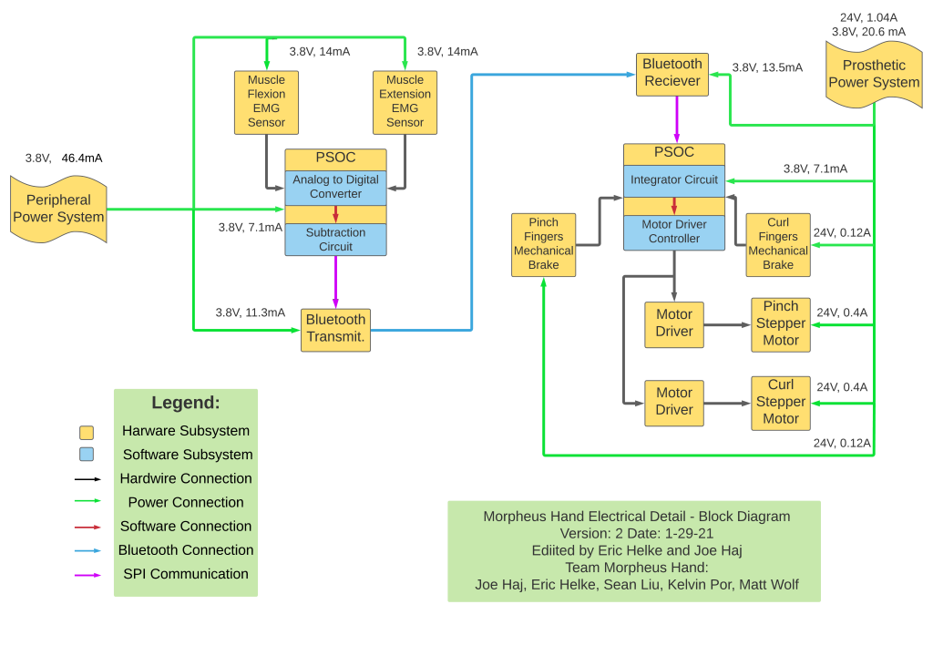
Electrical Block Diagram
Notes:
Eric

Slide 7
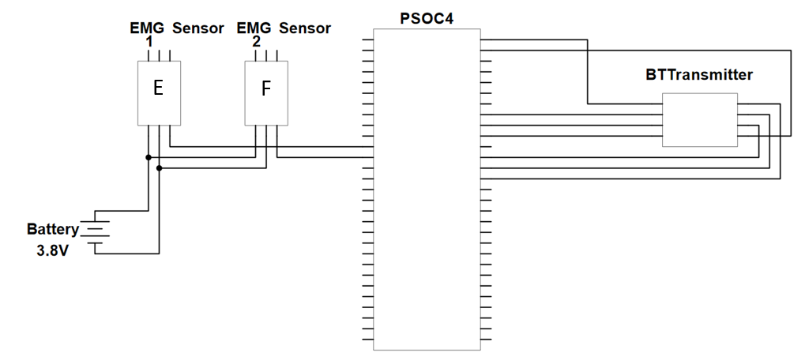
Electrical Schematic: Peripheral
Notes:
Eric

Slide 8
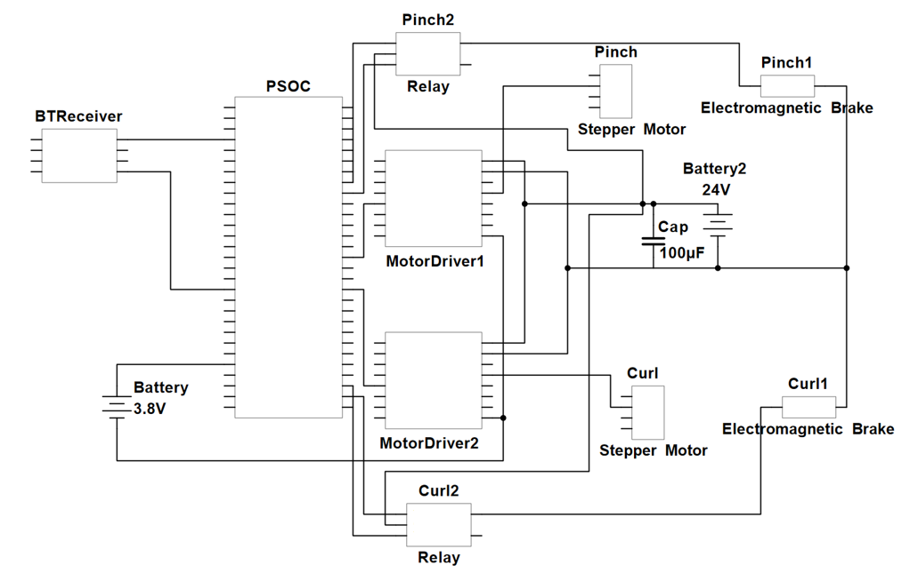
Electrical Schematic: Prosthetic
Notes:
Eric

Slide 9
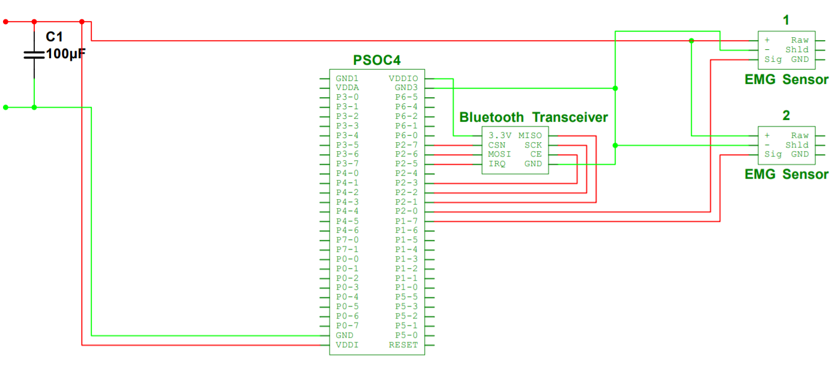
Electrical Wiring: Peripheral
Legend:
Red Wire: Top Layer
Green Wire: Bottom Layer
Notes:
Eric

Slide 10
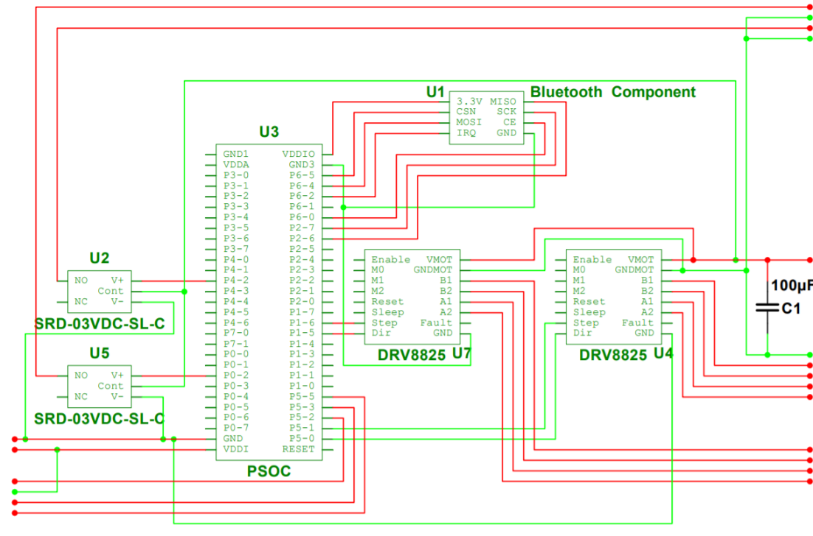
Electrical Wiring: Prosthetic
Legend:
Red Wire: Top Layer
Green Wire: Bottom Layer
Notes:
Eric

Slide 11
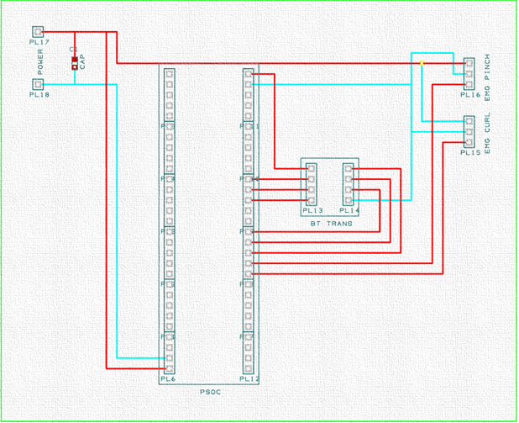
PCB Design: Peripheral
Notes:
Eric

Slide 12
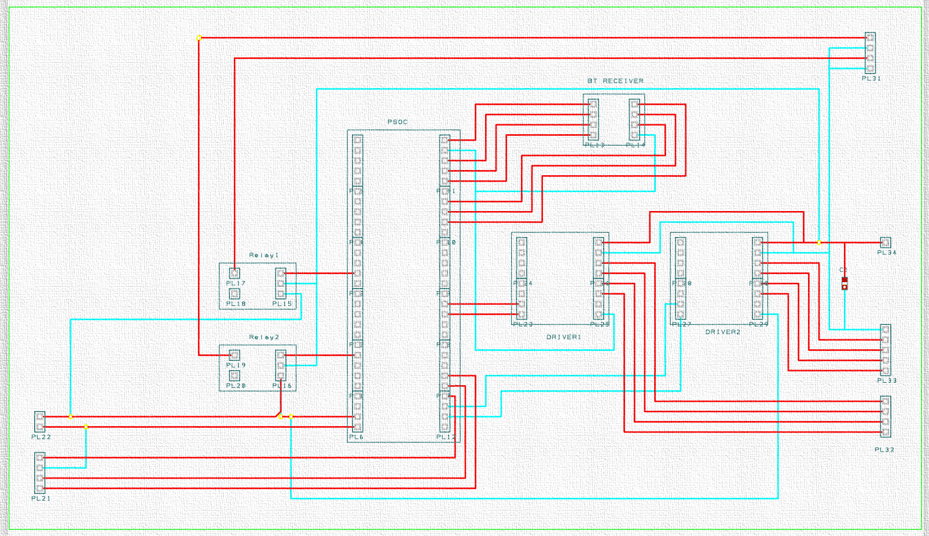
PCB Design: Prosthetic
Notes:
Eric

Slide 13
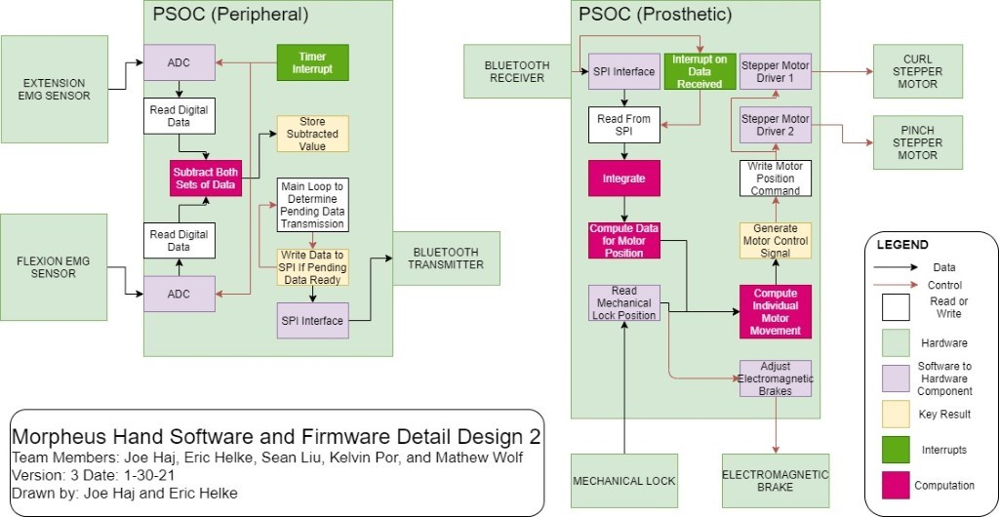
Software/Firmware Block Diagram
Notes:
Joe

Slide 14
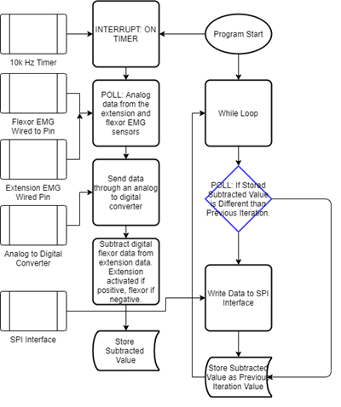
Software Routine: Peripheral
Notes:
Joe

Slide 15
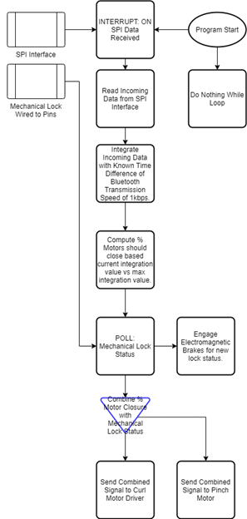
Software Routine: Prosthetic
Notes:
Joe

Slide 16
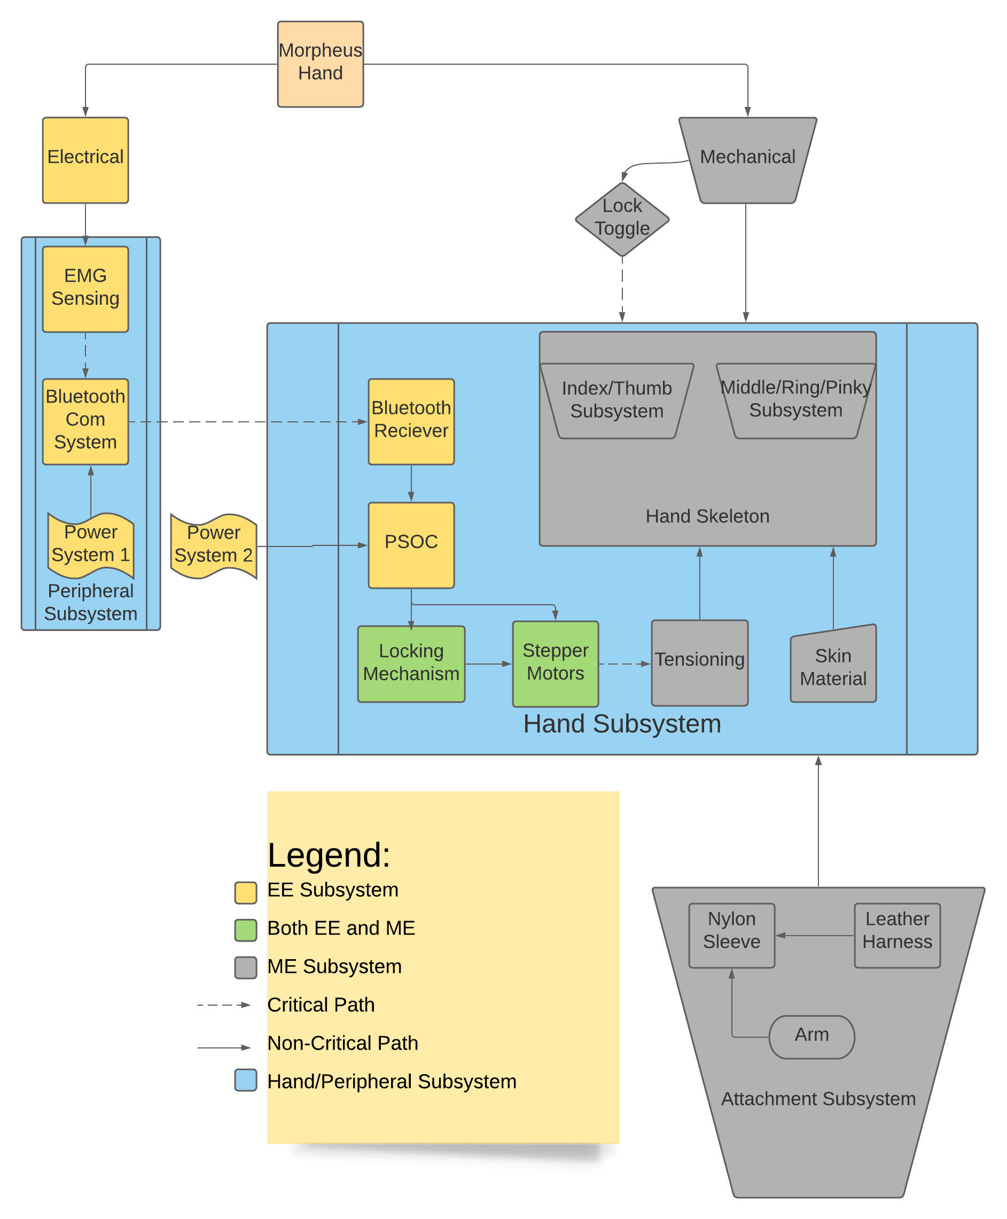
Mechanical Block Diagram

Slide 17
Mechanical Drawing

Slide 18
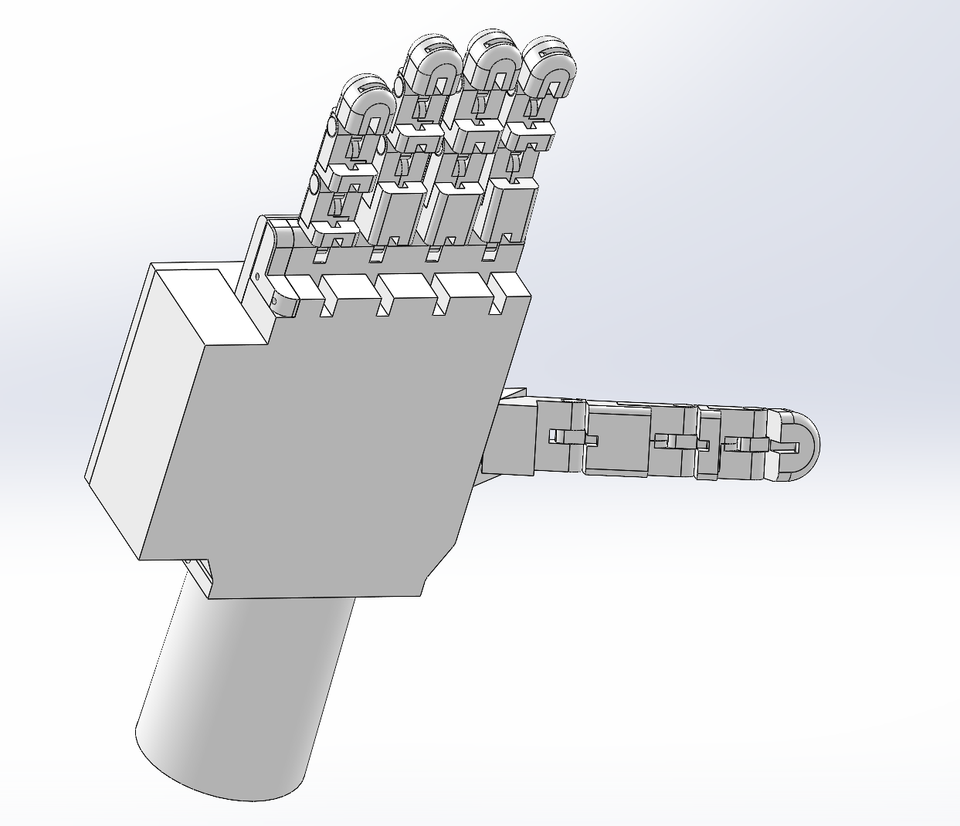
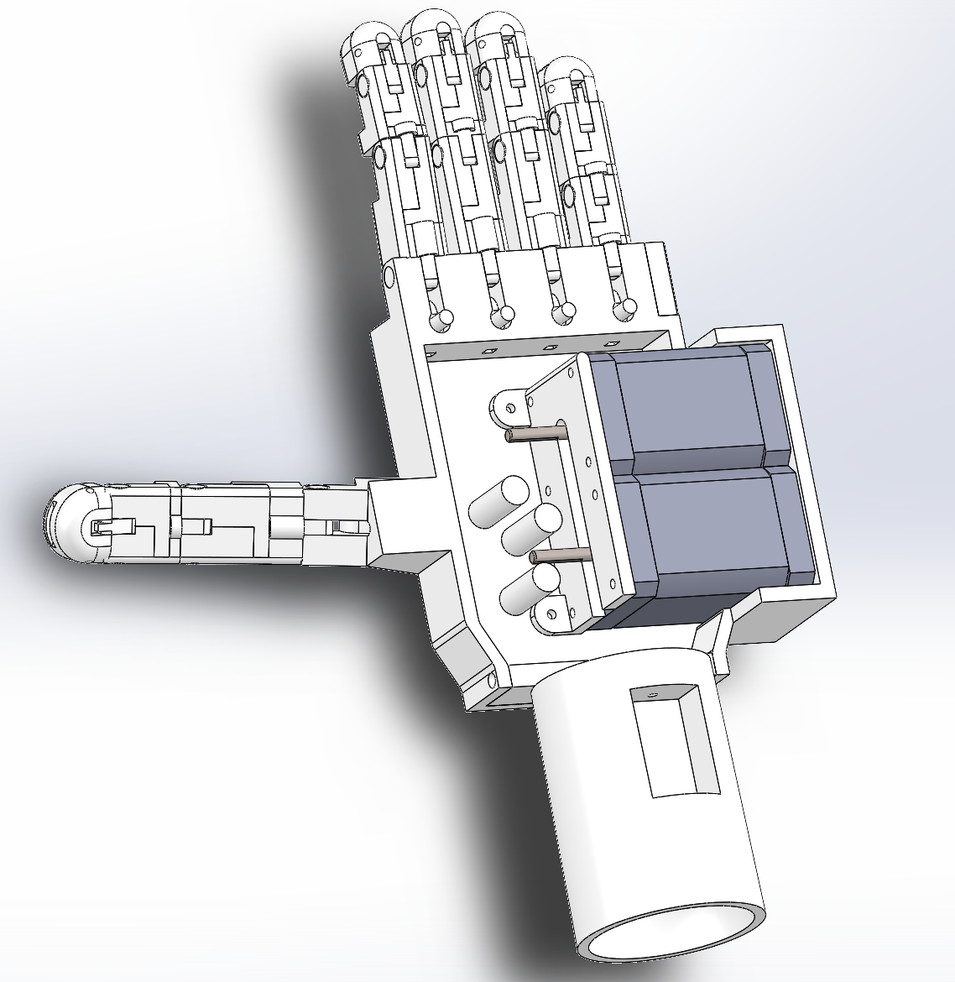
Mechanical Assembly

Slide 19
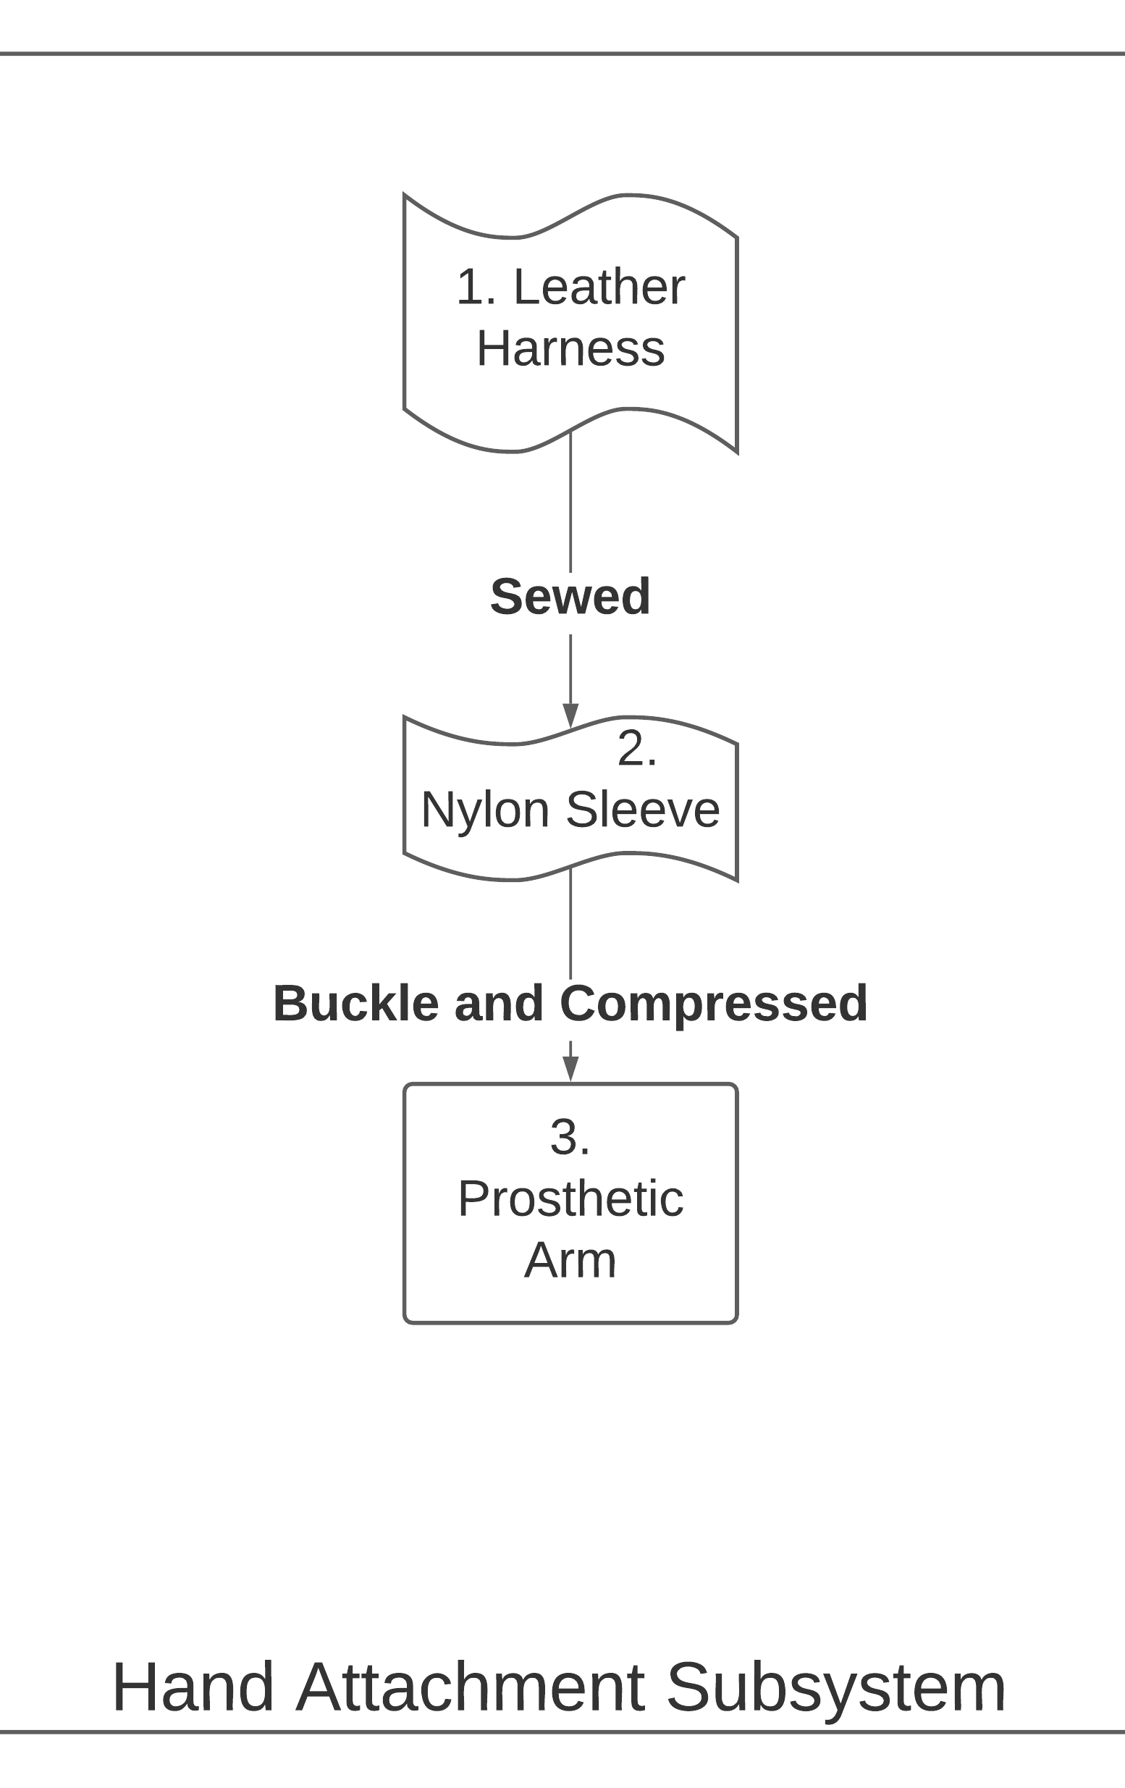
Mechanical Connection Scheme Part 1

Slide 20
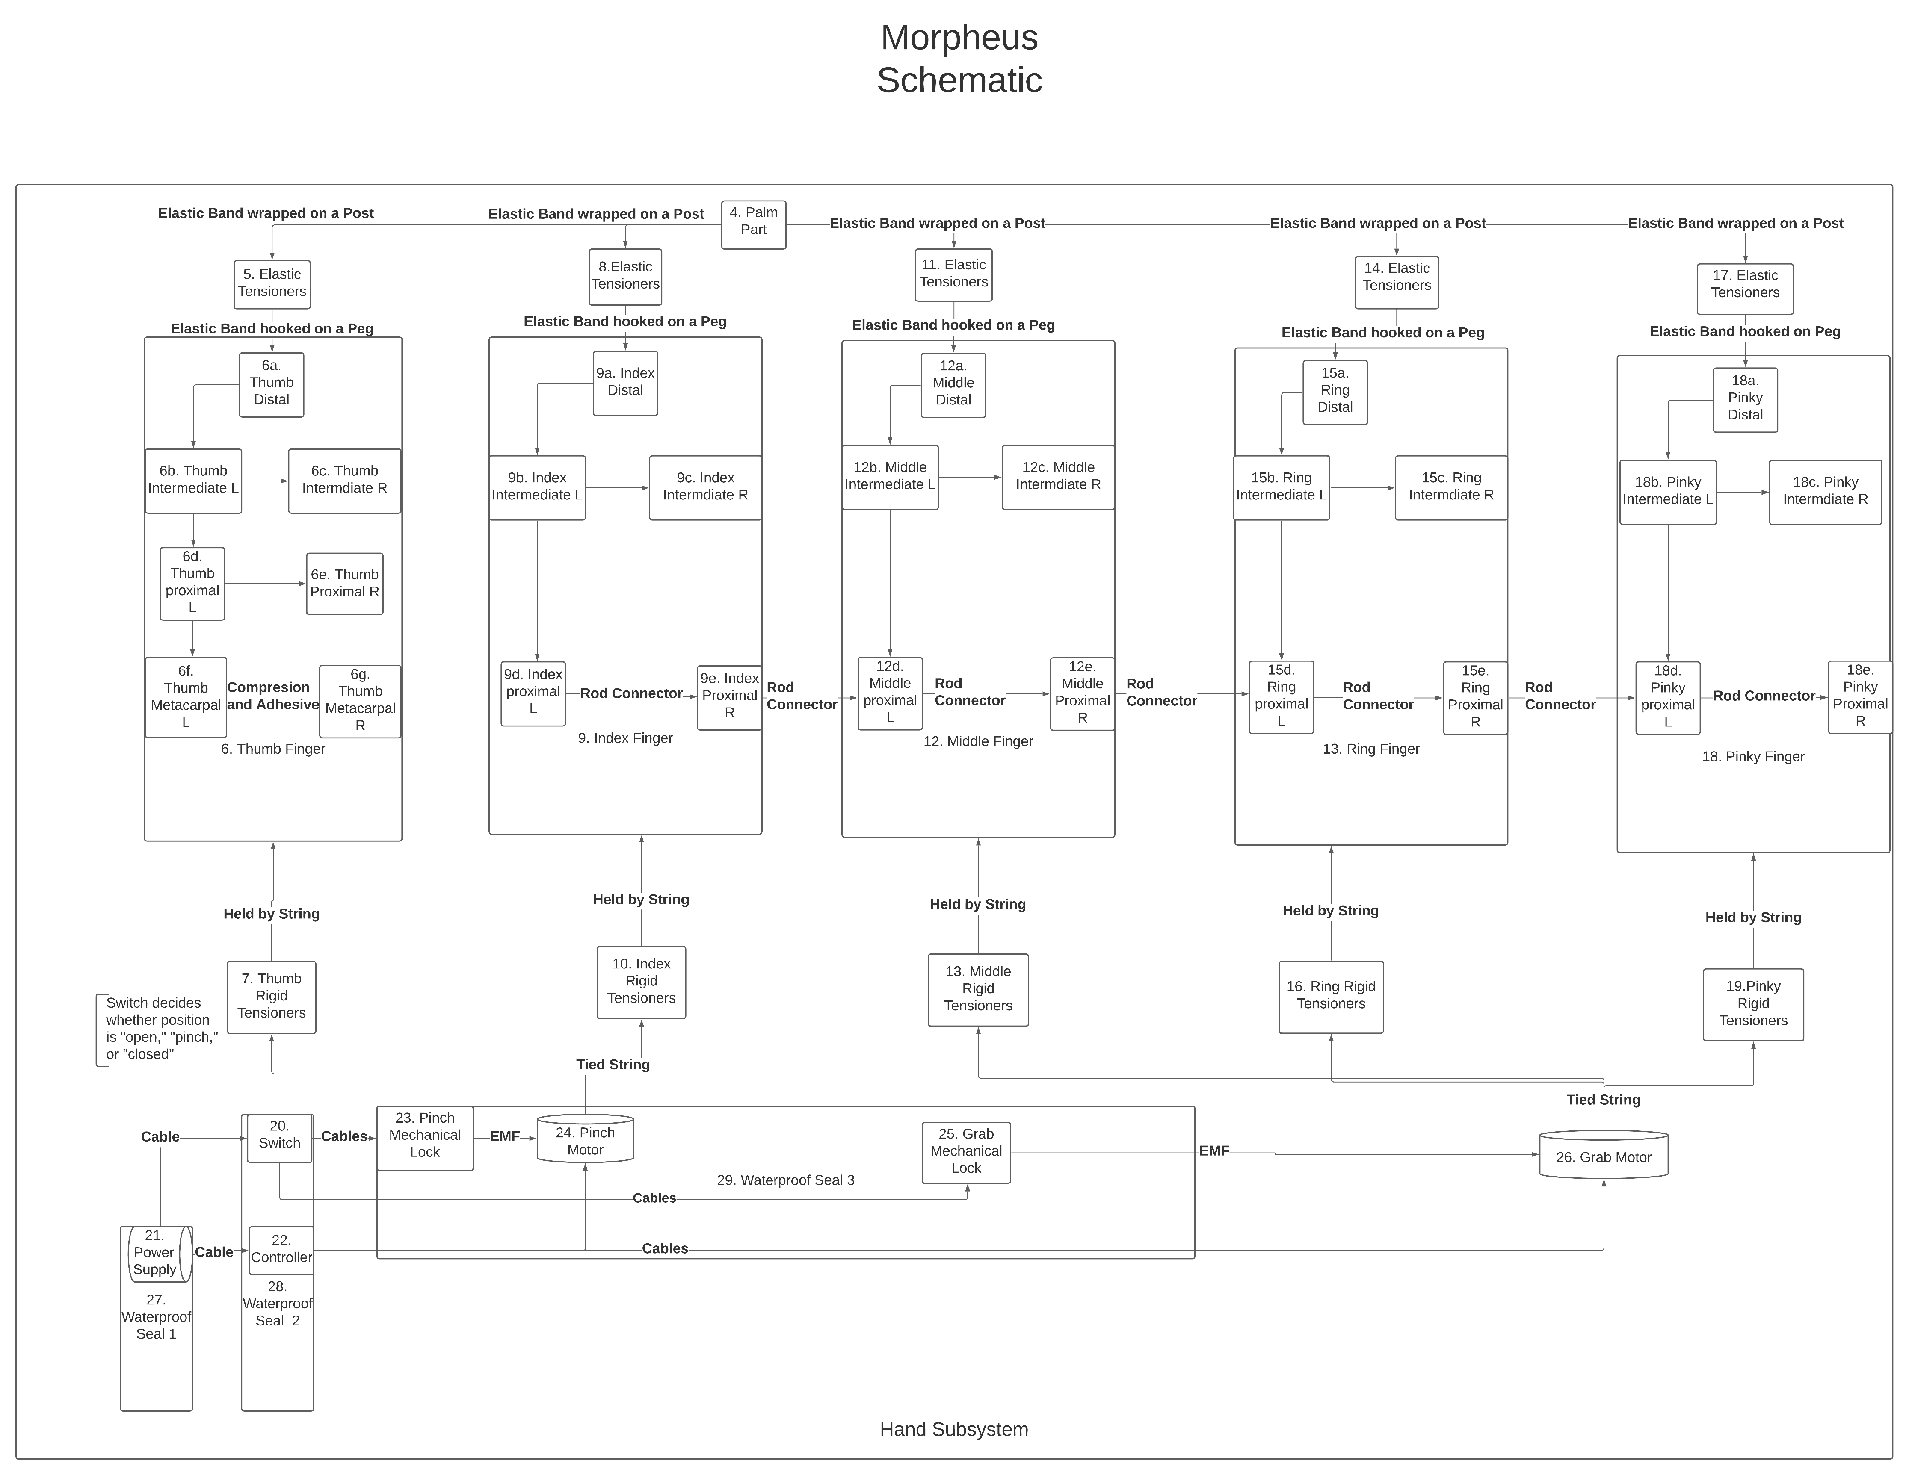
Mechanical Connection Scheme Part 2

Slide 21
Manufacturing Plan
(Part ID) | 1
(Part Name) | Leather Harness
(Part Connection) | 2 by sewing
(Manufacturing Process) | Purchased online
(Material Stock) | 0.14g
(Purchasing Source) | https://www.amazon.com/gp/product/B01L857HY2/ref=ppx_yo_dt_b_asin_title_o00_s00?ie=UTF8&psc=1
2 | 3
Nylon Sleeve | Prosthetic Arm
1 by sewing 3 by compression and buckle | 2 by compression and buckle 4 by screws 28 by enclosure
Purchased at fabric store | 3D printed
0.082 lb/0.077 lbs (full arm/partial arm) | 0.47 lbs
Joann’s | N/A

Slide 22
4 ​ | 5 ​
Palm Part ​ | Thumb Elastic Tensioner ​
3 by screws ​ 5, 8, 11, 14, 17 secured by post ​ 6f, 9d, 12d, 15d, 17d by pin ​ | 4 by post ​ 6a by post ​
3D printed ​ | Purchased at hardware store ​
0.38 lbs ​ | N/A ​
N/A ​ | ACE ​
6a ​ | 6b ​
Thumb Distal ​ | Thumb Intermediate L ​
5 by post ​ 6b by peg ​ 7 by post ​ | 6a by peg ​ 6c by adhesive ​ 6d by peg ​
3D printed ​ | 3D printed ​
0.02 lbs ​ | 0.011 lbs ​
N/A ​ | N/A ​
3D printed ​ | 3D printed ​
0.0078 lbs ​ | 0.01 lbs ​
N/A ​ | N/A ​

Slide 23
6c | 6d
Thumb Intermediate R | Thumb Proximal L
6b by adhesive | 6b by peg 6e by adhesive 6f by peg
3D printed | 3D printed
0.0039 lbs | 0.022 lbs
N/A | N/A
6e | 6f
Thumb Proximal R | Thumb Metacarpal L
6d by adhesive | 4 by peg 6d by peg 6g by adhesive
3D printed | 3D printed
0.0078 lbs | 0.01 lbs
N/A | N/A
6g | 7
Thumb Metacarpal R | Thumb Rigid Tensioner
6f by adhesive | 6a by post 24 by knot
3D printed | Purchased at hardware store
0.01 lbs | 7 in
N/A | ACE

Slide 24
8 | 9a
Index Elastic Tensioner | Index Distal
4 by post 9a by post | 8 by post 9b by peg 10 by post
Purchased by hardware store | 3D printed
N/A | 0.01 lbs
ACE | N/A
9b | 9c
Index Intermediate L | Index Intermediate R
9a by peg 9c by adhesvie 9d by peg | 9b by adhesive
3D printed | 3D printed
0.0078 lbs | 0.0037 lbs
N/A | N/A
9d | 9e
Index Proximal L | Index Proximal R
4 by peg 9b by peg 9e by adhesive | 9d by adhesive
3D printed | 3D printed
0.015 lbs | 0.0052 lbs
N/A | N/A

Slide 25
10 | 11
Index Rigid Tensioner | Middle Elastic Tensioner
9a by post 24 by knot | 4 by post 12a by post
Purchased at hardware store | Purchased at hardware store
7 in | N/A
ACE | ACE
12a | 12b
Middle Finger Distal | Middle Finger Intermediate L
11 by post 12b by peg | 12a by peg 12c by adhesive 12d by peg
3D printed | 3D printed
0.01 lbs | 0.0091 lbs
N/A | N/A
12c | 12d
Middle Finger Intermediate R | Middle Finger Proximal L
12b by adhesive | 4 by peg 12b by peg 12e by adhesive
3D printed | 3D printed
0.0039 lbs | 0.015 lbs
N/A | N/A

Slide 26
12e | 13
Middle Finger Proximal R | Middle Rigid Tensioner
12d by adhesive | 12a by post 26 by knot
3D printed | Purchased at hardware store
0.0052 lbs | 7 in
N/A | ACE
14 | 15a
Ring Elastic Tensioner | Ring Distal
4 by post 15a by post | 14 by post 15b by peg
Purchased at hardware store | 3D printed
N/A | 0.01 lbs
ACE | N/A
15b | 15c
Ring Intermediate L | Ring Intermediate R
15a by peg 15c by adhesive 15d by peg | 15b by adhesive
3D printed | 3D printed
0.0077 lbs | 0.0037 lbs
N/A | N/A

Slide 27
15d | 15e
Ring Proximal L | Ring Proximal R
4 by peg 15b by peg 15e by adhesive | 15d by adhesive
3D printed | 3D printed
0.015 lbs | 0.0052 lbs
N/A | N/A
16 | 17
Ring Rigid Tensioner | Pinky Elastic Tensioner
15a by post 26 by knot | 4 by post 18a by post
Purchased at hardware store | Purchased at hardware store
7 in | N/A
ACE | ACE
18a | 18b
Pinky Distal | Pinky Intermediate L
17 by post 18b by peg | 18a by post 18c by adhesive 18d by peg
3D printed | 3D printed
0.01 lbs | 0.0077 lbs
N/A | N/A

Slide 28
18c | 18d
Pinky Intermediate R | Pinky Proximal L
18b by adhesive | 4 by peg 17b by peg 18e by adhesive
3D printed | 3D printed
0.0037 lbs | 0.0037 lbs
N/A | N/A
18e | 19
Pinky Proximal R | Pinky Rigid Tensioner
18d by adhesive | 18a by post 26 by knot
3D printed | Purchased at hardware store
0.0033 lbs | 7 in
N/A | ACE
20 | 21
Switch | Power Supply
21, 23, 25 by cable 28 by enclosure, screws | 20, 22 by cable 27 by enclosure, screws
Purchased online | To be purchased
N/A | N/A
 | N/A

Slide 29
22 | 23
Controller | Pinch Mechanical Lock
21, 24, 26 by cable 28 by enclosure, screws | 20 by cable 24 by EMF 29 by enclosure, screws
Purchased PSOC, Bluetooth receiver online | To be purchased
N/A | N/A
 | https://www.omc-stepperonline.com/p-series-nema-17-stepper-motor-48ncm-67-99oz-in-with-electromagnetic-brake.html
24 | 25
Pinch Motor | Grab Mechanical Lock
7, 10 by knot 22 by cable 23 by EMF 29 by enclosure, screws | 20 by cable 26 by EMF 29 by enclosure, screws
Not yet purchased | Not yet purchased
N/A | N/A
https://www.omc-stepperonline.com/p-series-nema-17-stepper-motor-48ncm-67-99oz-in-with-electromagnetic-brake.html | https://www.omc-stepperonline.com/p-series-nema-17-stepper-motor-48ncm-67-99oz-in-with-electromagnetic-brake.html

Slide 30
26 | 27
Grab Motor | Waterproof Seal 1
22 by cable 25 by EMF 29 by enclosure, screws | 21 by enclosure, screws
Not yet purchased | To be 3D printed
N/A | N/A
https://www.omc-stepperonline.com/p-series-nema-17-stepper-motor-48ncm-67-99oz-in-with-electromagnetic-brake.html | N/A
28 | 29
Waterproof Seal 2 | Waterproof Seal 3
3 by enclosure 20, 22 by enclosure, screws | 4 by enclosure 23, 24, 25, 26 by enclosure, screws
To be 3D printed | To be 3D printed
N/A | 0.26 lbs
N/A | N/A

Slide 31
Mechanical Bill of Materials

Slide 32
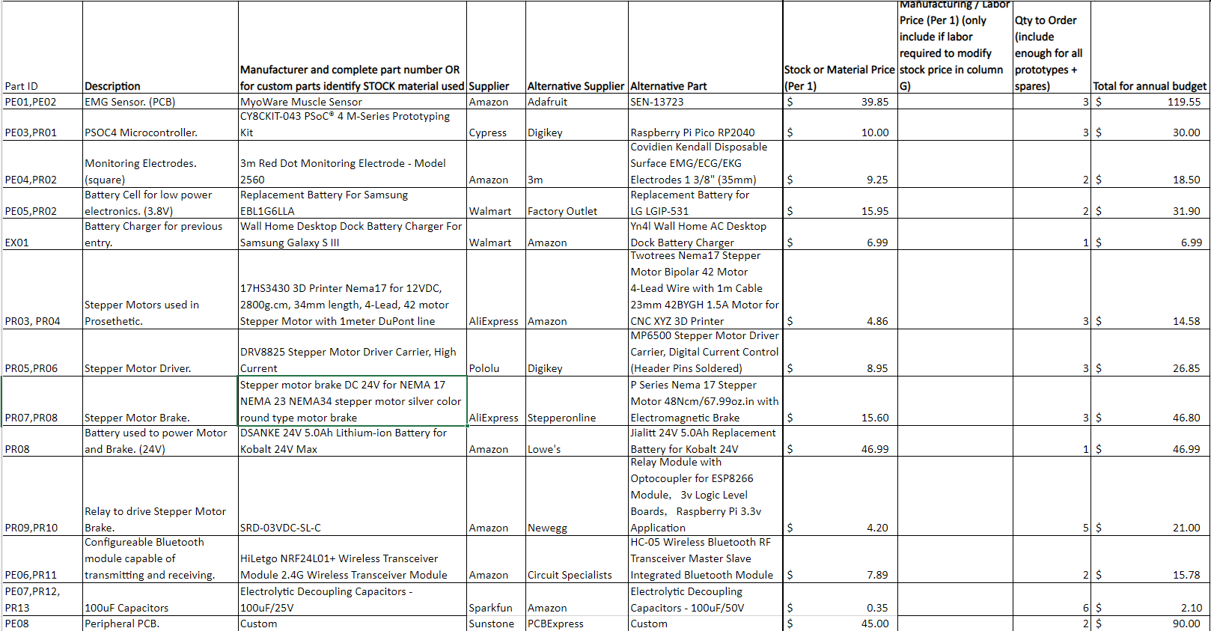
Electrical BIll of materials
Notes:
Joe

Slide 33
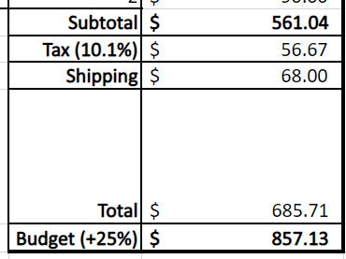
EBOM Highlights
Most expensive item/unit price: Motor and Brake battery @ $46.99
Most expensive item category: EMG Sensor @ $119.55
$39.85 each 3 Purchased
2 Required, 1 Spare

Slide 34
Engineering Analyses
Mechanical Analyses
Electrical Analyses
Durability
Mechanical Design
Motor Power
Tension
Structural Analysis
Weight Analysis
Path Loss and Signal Strength
Power Consumption
Notes:
Joe

Slide 35
Pathloss and Signal Strength
Equations:
Received Signal Strength (RSS) = Transmitted Power – Pathloss
Pathloss (Free Space):$20log_{10}f+20log_{10}d−147.56 dB$
Assumptions:
Unobstructed for Free Space Propagation.
Transmitting at highest power and fastest data rate.
Frequency of Bluetooth signal is 2.4 Ghz.
Results:
@ 4 ft RSS = $−41.7657 dBm$
@ 8 ft RSS = $−47.7863 dBm$
Given Receiver Sensitivity = $−82 dBm$
Theoretical max transmission distance is $125.253$ meters.
Notes:
Joe

Slide 36
Power Consumption
Equations:
P=VI
P=$I^{2}$R
$P_{total}=\sum{P_{components}}$
Assumptions:
Components are drawing max current from datasheet.
Added 33% to power computation.
3 Separate Power Sources
Peripheral 3.8V Power Source:
PSOC 4, Bluetooth Transmitter, and 2 EMG sensors
Prosthetic 3.8V Power Source:
PSOC 4, and Bluetooth Receiver
Prosthetic 24V Power Source:
2 stepper motor brakes, and 2 stepper motors.
Results:
Power consumption of the peripheral source: $234.48 mW$
Power consumption of the 3.8V prosthetic source: $104.087 mW$
Power consumption of the 24V prosthetic source: $20.4288 W$
Notes:
Joe

Slide 37
Durability
Our material is PLA
From tables found on https://www.creativemechanisms.com/blog/learn-about-polylactic-acid-pla-prototypes
Tensile strength ~ 8840 psi
Flexural stength ~ 6960 psi
Melting temperature ~ 315°F

Slide 38
Mechanical Design
We wanted to design the hand to mimic a human hand

Slide 39
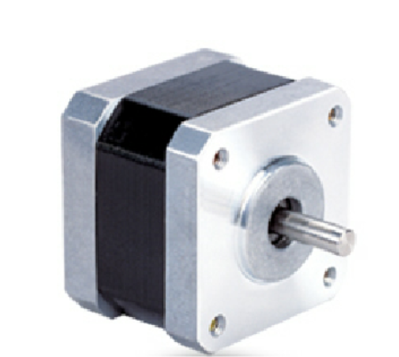
Motor Power
Series Model | Holding Torque (N.cm Min) | Detent Torque (N.cm Max) | Rotational Inertia (g.cm²)
17HS3430 1.8 | 28 | 1.6 | 34

Slide 40
Tension + Structural Analysis
Currently untested as they required a physical model to test and analyze.

Slide 41
Weight Analysis
Found on SOLIDWORKS, hand weighs 1.75 lbs
Motors weigh 1 lb combined
Motor Brakes weigh ~ 1 lb
Others (screws, rubber bands, yarns) ~ .25 lbs
Total weight of the hand so far ~ 4 lbs

Slide 42
New Analyses
Mechanical Analyses
Electrical Analyses
Circuitry Operation Hours
Notes:
Joe

Slide 43
Questions?

Slide 44
Additional Slides

Slide 45
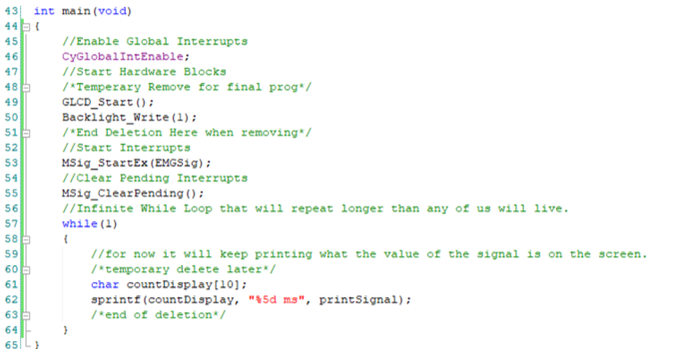
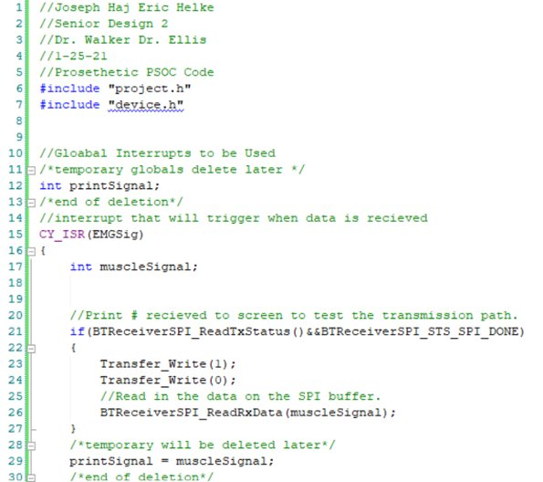
Prosthetic Code Sample
Working on 1st confirming out Bluetooth transmission is operating. GLCD is not compatible so will be updated to be done with LED outputs.
Comments mostly filled in for each block for quick placement when writing.

Slide 46
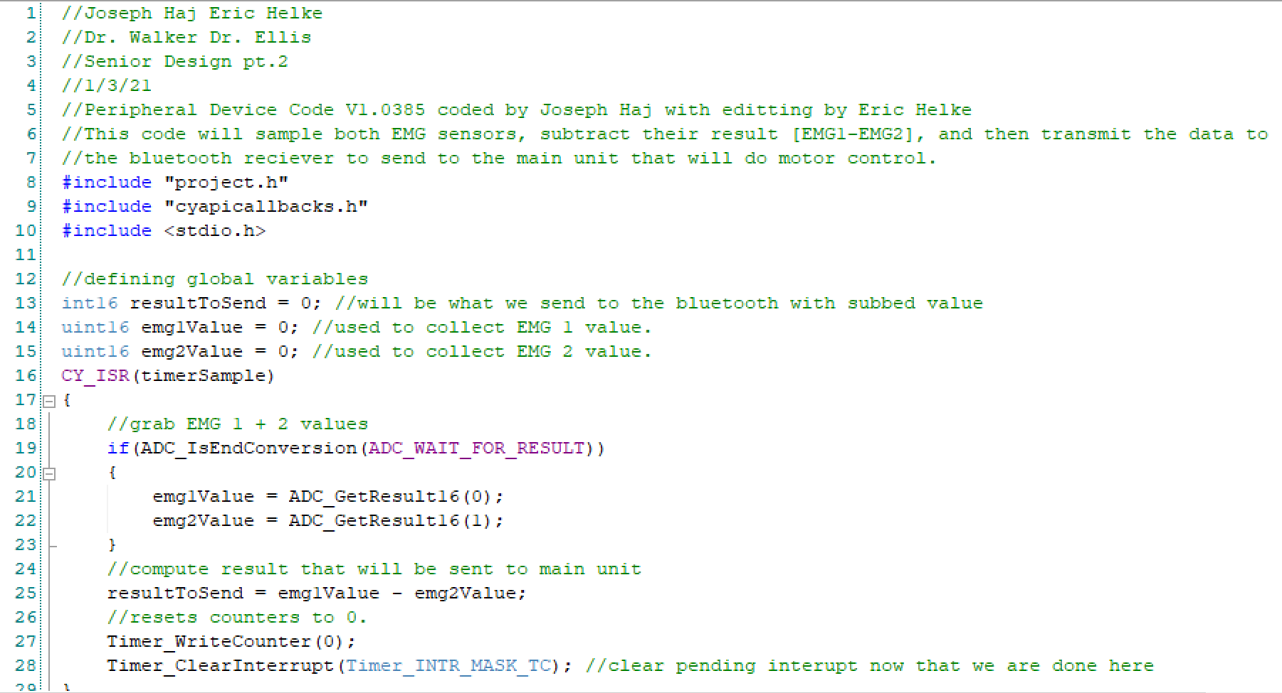
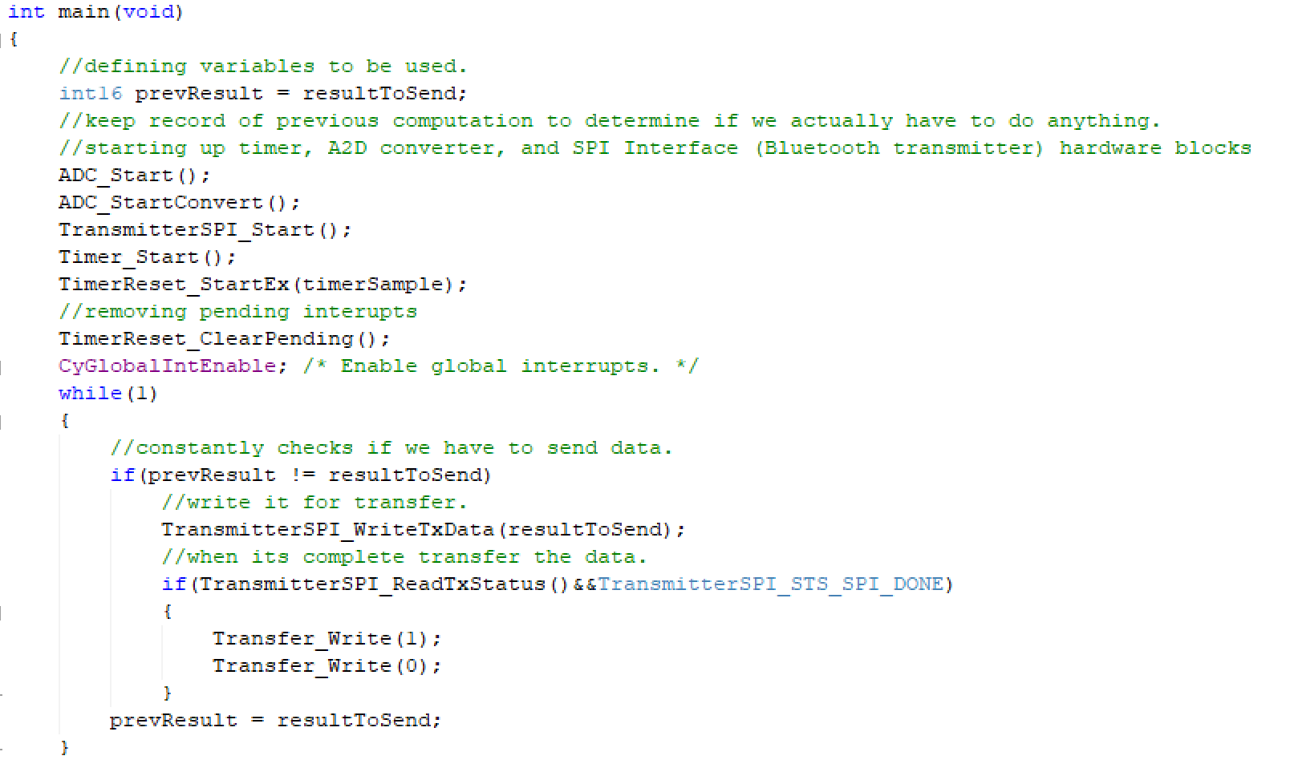
Peripheral Code Sample
Working on first collecting data from the EMG sensors, then processing that data, and then sending it out via Bluetooth.

